Slide 1



Formative Evaluation of the Cash Based Assistance (CBA) Programme in Afghanistan
(2020 to March 2023)
Final evaluation PPT slides

Slide 2
Background and objectives
Background
The Afghanistan Country Office (ACO) began the cash programme in 2020 with exponential growth in participant caseload since then. Operations are conducted in a highly complex and fragile context, made more challenging by the non-formalized relations with the Taliban as the de facto authority (DfA).
Objectives
The evaluation was commissioned by the ACO to review partnerships, coordination and monitoring for effective delivery, guide the expansion of UNICEF CBA and draw lessons learned for the eventual support of the nascent social protection system.

Slide 3
ACO cash programme
Humanitarian cash programmes: early support and emergencies
(1-3 months)
Regular cash to households every month (planned for 3 years)
Cash+: achieve specific sector outcomes
(up to 1 year)
Gender-sensitive processes and social behaviour change activities to be incorporated into all cash interventions.
Evidence generation and learning to enable replication in similar contexts and use in building the national social protection system.

Slide 4
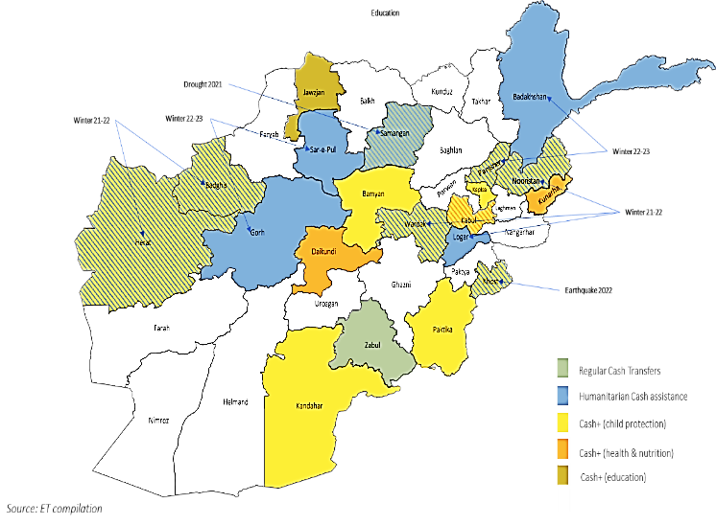
Scope and approach
Theory-based evaluation utilising a reconstructed Theory of Change as the analytical framework. Mixed methods data collection involved a household survey (868 HHs), key informant interviews (84), focus group discussions with men (14 FGDs) and in-depth interviews with women (44) and a literature review.
The evaluation covered all CBA programmes in the 20 provinces designed and implemented since 2020. included thematic focus areas aligned with CBA programme objectives including health, education, nutrition, child protection, social protection and humanitarian response. Additionally, the evaluation sought to assess CBA programme alignment with accountability to affected populations commitments and human rights and gender elements.
The combination of a lack of clarity on design objectives, restrictions on primary data collection and limited availability of up-to-date secondary data were important limitations which impacted the evaluation. While the ET sought to overcome these challenges, they presented evaluability challenges for most criteria and specifically for assessing relevance and effectiveness as well as Human Rights (HR) and Gender Equity and Women’s Empowerment GEWE as a cross-cutting issue.

Slide 5
Evaluation findings

Slide 6
Relevance (EQ1-4)
Strategic alignment
Relevant to meet short term needs but lacks longer-term inputs to achieve both objectives of the strategy
Activity design
Missing design documents for many HCT and cash+ programmes limits assessment
Supports four of the five goals of the 2021-2025 GAP
Objectives are generally limited to successful cash distribution, for which activities are consistent.
Designs prioritising women and children may not be necessary or sufficient to empower women and girls
Relevance (EQ1-4)

Slide 7
Relevance (EQ1-4)
Targeting
Most key informants affirmed the strategy’s focus on categorical targeting separate from ethnic or cultural considerations.
Gender and equity considerations
IPs took practical steps to enhance inclusion of women
No specific gender objectives, indicators or targets to assess relevance
Further understanding is needed on the risks and vulnerabilities of key groups to ensure equitable inclusion
Vulnerable people are reached but universal targeting criteria are too broad to ensure prioritization of the most vulnerable people
Relevance (EQ1-4)

Slide 8
Relevance (EQ1-4)
Cash actors
Coordination has gradually been decentralized with increasing OCHA staffing to support coordination
There could be an overlap in services, but it was not apparent
Coordination
WFP is the biggest cash actor in terms of budget operating nation-wide
The ban on women staff is negatively affecting INGO/UN capacity to deliver cash
Coherence (EQ5)

Slide 9
Relevance (EQ1-4)
Cash and Voucher Working group
CVWG mostly an advisory body; it does not provide operational coordination
Internal coherence
CBA programmes are well aligned/complementarity to the HAC 2022
Complementarity with non-cash interventions is limited
CBAs largely follow CVWG technical guidance though transfer values and frequency has not always adhered to guidance
The SPEAR unit provides less attention to the CVWG
Programme staff are not involved in CBA programme implementation
Areas for improvement
Area-based approaches and work with livelihoods actors could reportedly increase impact
New collaborations in health and nutrition offer opportunities for more strategic coordination with other cash actors
Increased reporting on CBA was suggested to make efforts more visible
M&E processes do not capture outcome and impact measurements
Coherence (EQ5)

Slide 10
Relevance (EQ1-4)
Meeting cash distribution objectives
Meeting sectoral and cross-cutting objectives
There are no processes yet for evaluating the effectiveness of programming on the empowerment of women and girls; these are planned for the RCT programme.
Cash distribution and participant targets have largely been met based on available data in programme agreements
There is not sufficient evidence to assess contribution to more complex objectives (e.g. reducing negative coping strategies)
Based on the ET’s limited analysis there are no notable differences in change in ability to meet needs based on households with different needs, such as those with a person with disabilities or among households headed by women.
PDM data shows increased access to goods/services for most participants but there are not consistent and robust baselines to determine the degree to which cash improves household’s ability to meet their basic needs
Effectiveness (EQ7-13)

Slide 11
Relevance (EQ1-4)
Cash delivery
Cash-in-hand is the most effective in UNICEF’s AOIs (for now)
Participant registration and data management
The centralized participant database would be more easily shareable, though currently data is not shared between cash actors
No specific attempts seem to have been made to ensure implementation is sensitive to different needs and realities of diverse groups
Distribution processes have been adjusted to increase distribution effectiveness
Stakeholders specify need to conduct household-level assessments, refine targeting criteria, and increase IP capacity to follow UNICEF SOPs and improve household registration
ACO staff are positive about use of “HOPE” for registration and data management
Effectiveness (EQ7-13)

Slide 12
Relevance (EQ1-4)
+ Partnerships model
+ Working with local IPs and MSP
+ Expertise of PMU
+ UNICEF's reputation as a "good partner"
- Low transfer value
- Short transfer duration
- Decreasing donor funding
- Challenges in coordination and access
- Increasing restrictions on GEWE
Effectiveness (EQ7-13)

Slide 13
Relevance (EQ1-4)
Timeliness
UNICEF and IPs put in place several mechanisms and mitigation measures to alleviate access constraints, a main challenge to programme efficiency
Communication with participants
Communication during mobilisation was broadly effective in informing on targeting criteria; there was limited knowledge of project’s wider objectives
Participants show low awareness of GRM despite IP insistence of global knowledge
There is room for improvement in consolidating the inputs of the different feedback channels and closing the feedback loop
Some CBA programmes experience long delays; mostly related to external factors (access and donor funding)
Programming at scale has efficiency gains in delivery processes
Efficiency (EQ14-17)

Slide 14


Positive feedback overall
Feedback from those participants who did not find the location/timing convenient signifies access barriers to specific populations including persons with disabilities
Transportation costs are frequently reported; there is not sufficient information to determine whether costs are disproportionately large according to ethnicity or cultural background
Efficiency (EQ14-17)
91% per cent of PDM respondents reported that the location was convenient
96% per cent reported the timing as ‘convenient’.

Slide 15
Evaluability challenges in assessing this EQ
In general, participants, community leaders, IPs and ACO stakeholders did not note any significant positive or negative effect on intra-household gender relations.
Some positive indication from PDM respondents; over half reporting that the program decreased tensions within their household (not gender-specific tensions)
Impact-gender relations (EQ18)

Slide 16



Sustainability (EQ19-21)
Household and individual benefits
The impact of humanitarian assistance is not aimed to be sustainable
Transfer to national social policy programme
Best practices to ensure transferability are already utilised by UNICEF
Partnerships with NGOs building local capacity
Support to children in the first 1,000 days can have a profound effect on a child’s future, though quantifying this effect is not possible with available data
Running a digital management information system (MIS) for future transferability
Continued exploration of electronic payment systems for efficient payment management

Slide 17






Lessons learned for scaling up cash programming
Donor engagement strategies need to be reviewed to ensure UNICEF is interacting with the right donors at the right times to meet CBA programme objectives.
CBA objectives need to be reviewed in light of the imbalance between broad categorical targeting criteria and the resources available to fund programmes.
Ensuring an appropriate balance of cash and complementary service provision is also paramount to achieving CBA objectives.
The expertise and flexibility of the PMU has been essential to UNICEF’s success in scaling up cash assistance.
Investments in human resource capacity at sub-national level are equally important to scaling up cash assistance and should be expanded.
UNICEF has the experience to lead in the deployment of digital systems for expansion and scale-up of CBA.
Liquidity issues should be monitored to assess MSP capacity to meet distribution needs.

Slide 18
Relevance (EQ1-4)
Recommendation 1: As UNICEF is planning to expand its CBA activities, the expertise coming from the PMU needs to be completely integrated into the country office architecture.
Recommendation 2: Additional efforts should be invested into gender and social behaviour change related activities especially when related to the Cash+ and regular cash programmes.
Recommendation 3: UNICEF should invest resources in measuring the outcomes of Cash+ and regular cash programmes to i) ensure expected outcomes are reached, ii) re-orientate programming if needed, and iii) provide evidence to donors for possible increased funding.
Recommendation 4: UNICEF needs to continue working towards separating implementation partners and monitoring partners.
Recommendation 5: UNICEF should find mitigation measure ensuring timely winter cash assistance.
Recommendation 6: To provide a more holistic response to the Afghan people, UNICEF should collaborate more with other actors so that the CBA results can be further leveraged. Partnerships with external actors in livelihoods, community level WASH, etc. could enhance UNICEF core programming outcomes in a more sustainable way.
Recommendation 7: UNICEF should support regional sub-offices to conduct detailed assessments to inform more localised vulnerability criteria for CBA programmes planned.
Recommendation 8: During the participant selection process, UNICEF should ensure all measures are put in place to ensure a transparent and well accepted procedure.
Recommendation 9: UNICEF should ensure that communication around the different CBA components is better disseminated:
Recommendation 10: The cost of transportation to the distribution points should not be borne by the participants.
Recommendations

