Slide 1


‘From Guidelines to Action’ (FG2A)
Webinar: Introducing the Guidance on making protection assessments more disability-inclusive
Notes:
Support the operationalisation & localisation of the IASC ‘Guidelines on Inclusion of Persons with Disabilities in Humanitarian Action’, through review, adapt & action learning labs (RAAL) for disability inclusive coordination, data collection and programming in Protection & Food security sectors.
3 results:
1 focusing on disability-inclusive coordination
2 focusing on guidance to adapt protection and food security assessment and monitoring tools
3 focusing on localizing the use of the IASC Guidelines -> two countries: Somalia and Syria
10-member TTF established in May 2022 to oversee inter-agency collaboration as per the IASC guidelines.....

Slide 2
Background
Persons with disabilities face disproportionately higher levels of risks due to barriers

Slide 3
Why this guidance & process of Guidance Development
Lack of available practical guidance to review, adapt and revise protection data collection tools & processes to ensure disability-specific barriers, risks, threats and capacities are considered.
Tool collection
General protection tools (IRC, UNICEF, UNHCR, GPC, HI) & barries & facilitator tools
First Review Grid development
Utilizing the IASC GL
Testing with review of tools
Identification of good practice & gaps
Review of protection tool
Establish Draft ZERO Review & Adaptation Guidance:
Review & adapt Workshop, at global and local levels
To use and adapt draft guidance
FINAL Draft Review & Adaptation Guidance
Dissemination
Based on good practices

Slide 4









Who was engaged?
10-member global Technical Taskforce (TTF) established in May 2022 as part of project
Engaged in development & review of the Guidance to adapt protection assessments
Colleagues attending a global protection review and adapt workshops from Global Protection Cluster, SC, IRC and others (September 2023)
Local and International NGOs as well as local OPDs working in Somalia that tested and provided feedback on using the guidance locally (October 2023)
Notes:
10-member TTF established in May 2022 to oversee inter-agency collaboration

Slide 5
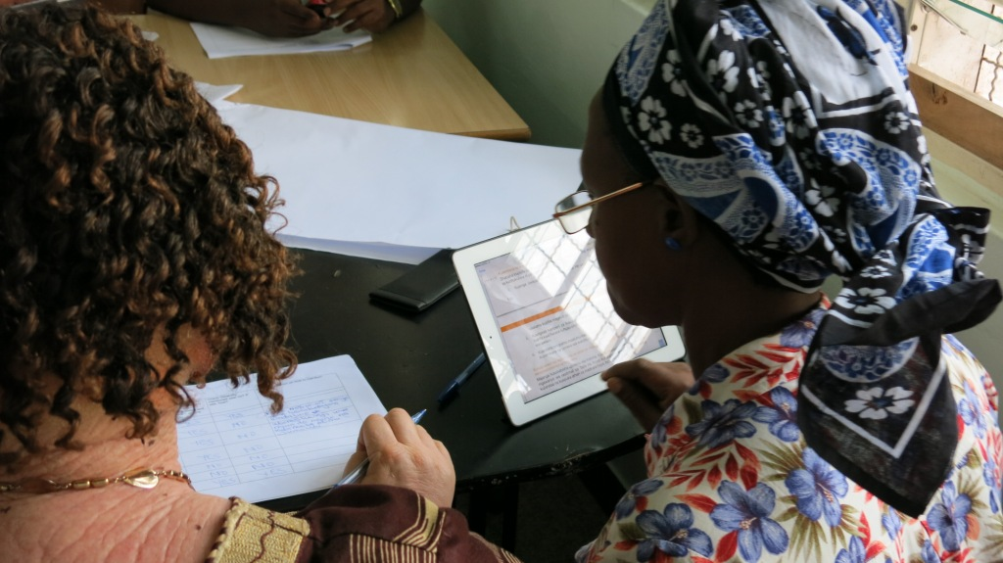
Objectives, foundations & intended users
Objective: To support humanitarian protection organisations that wish to adapt their protection data collection tools and processes to get better quality information on and with persons with disabilities.
Policy Foundation: IASC Guidelines on Inclusion of Persons with Disabilities in Humanitarian Action, and in particular the protection chapter
What shaped the feel and look: Inter-agency work, existing tools, inputs from field teams and global technical advisors, including OPDs
Target users: Mainstream humanitarian protection practitioners, in particular programming and technical advisors, as well as MEAL colleagues

Slide 6
What can be reviewed using this guidance?
Standard Operating Procedures (SOPs)/ guidances and processes
Assessment questionnaires and the process of administring:
  Focus Group Discussions, Key Informant, other Questionnaires
  Demographic sections
  Observation Tools & processes
  Feedback Mechanisms

Slide 7
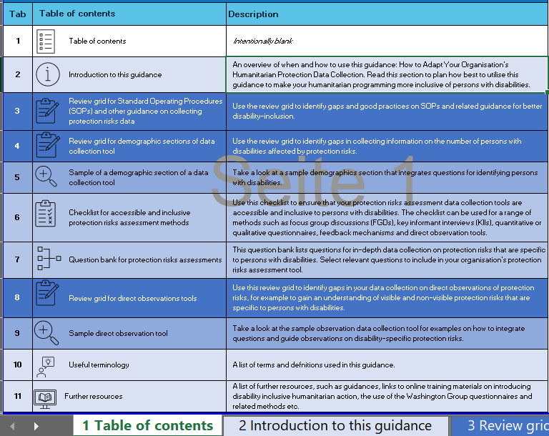
The overall structure of the guidance
Supporting tabs:
- Introduction
- Terminology
- Further Resources
Actual Guidance:
- 3 Review Grids
- 1 Checklist
- 1 Question bank
- 2 Sample tools

Slide 8
Recommended use, tba
Initial disability training – before adapting the tools
Setup a small cell/ task force, ideally MEAL and operation staff, invite OPD
Discuss which tools and part of assessment process to review, timelines & responsibilities
Review your protection data collection and tools, related guidance
Before finalizing consider consulting other program teams, the future users
Pilot or test adapted tools
Edit and finalize tools

Slide 9
How to approach your start…
You want to check whether this tools could be of interest & how it is to be used?
Use:
> Tab 2: Check more indepth information on purpose, scope and targeted users
> How-to Note for guidance
Your organization/ colleagues are new to Disability inclusion
Use:
Tab 11: pick the right learning resource from e-learning to online to face to face training modules & guidance

Slide 10
To review standard operating procedures (SOPs) & related Guidance
To identify gaps in your standard operating procedures & processes
Use:
> Tab 3: the review grid on SOPs,
> Tab 6: containing checklist for accessible assessment processes
To identify solutions for the gaps
Use the:
> Tab 3: Recommended actions & referenced practices
> Tab 6: Recommended actions of coulmn B

Slide 11
To review protection assessment questionnaires
To identify gaps in your questionnaire(s)
Use:
> Tab 4: Review grid for demographic sections,
> Tab 6: Checklist on accessible assessments, columns KII, FGDs & questionnaires
To identify solutions for the gaps
Use the:
> Tab 4: Recommended actions and referenced good practices
> Tab 5: sample demographic
> Tab 6: Checklist, recommended actions in column B relevant for your questionnaire
> Tab 7: Question bank for risks, origin of threat and capacities

Slide 12
To review Feedback and Complaint Mechanisms
To identify gaps in your protection related feedback and complaint mechanisms
Use: Tab 6, Checklist, column on Feedback and Complaint Mechanisms
To identify solutions for the gaps
Use the:
> Tab 6, Checklist, applicable recommended actions in column B for Feedback and Complaint Mechanisms,
> Tab 11, Resources section for further guidance on inclusive mechanisms

Slide 13
To review your observation tool and processes
To identify gaps in your observation tools & processes
Use:
> Tab 8: Review grid, on observations
> Tab 6: Checklist on accessible assessments, column observations
To identify solutions for the gaps
Use the:
> Tab 8: Recommended actions and referenced good practices
> Tab 6: Checklist, applicable recommended actions in column B for observations,
> Tab 9: sample observation tool

Slide 14
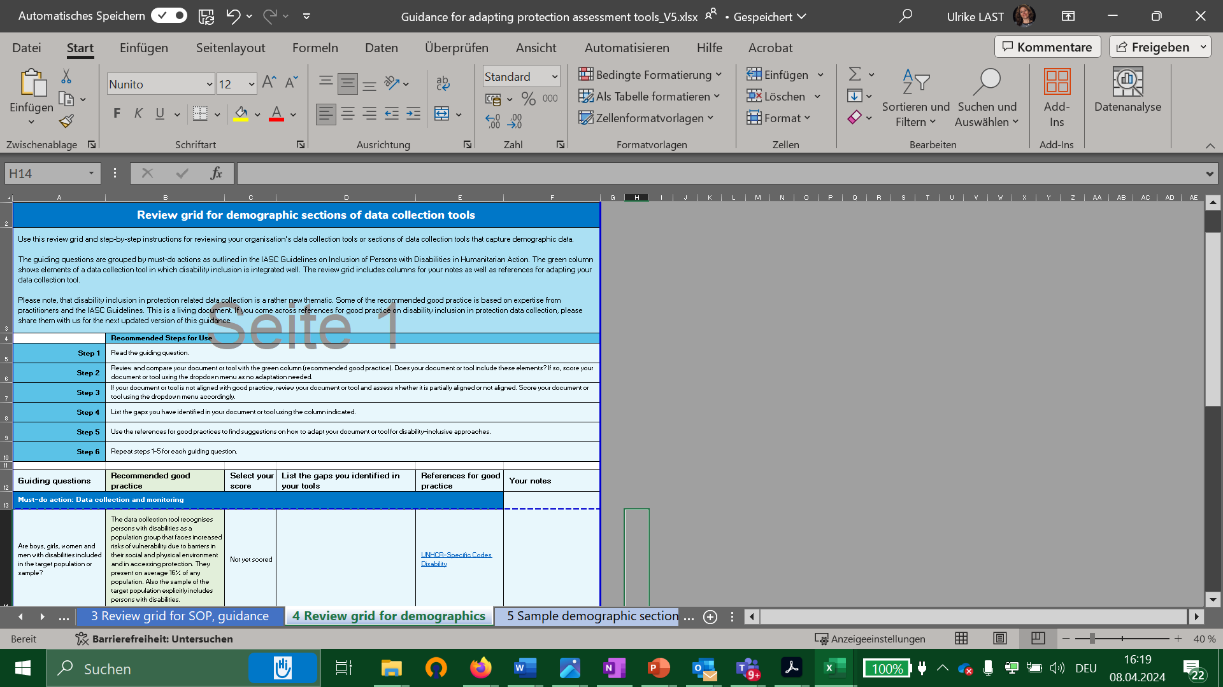
Structure of Review Grids
Background of this tab
Recommended steps
Review Grid

Slide 15
Structure of Review Grids
References for good pratice
Your notes for next steps
Guiding
questions
Recommended Good practice
Space to list gaps
Score

Slide 16
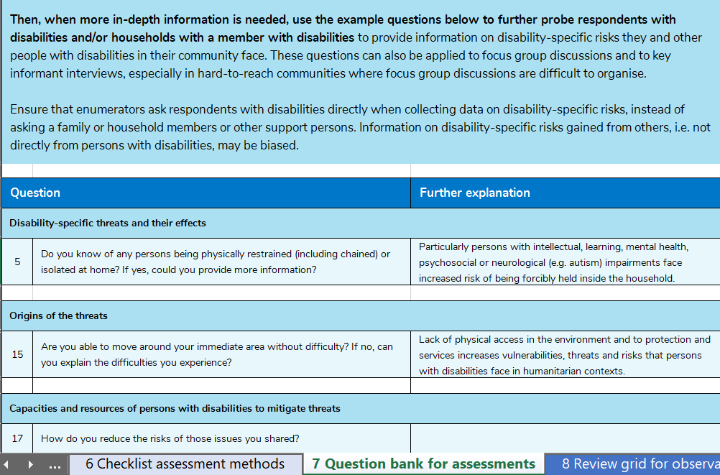
Question Bank
Background & use
Questions to explore disability-specific threats
Questions to explore origins of threats
Questions to explore capacities

Slide 17
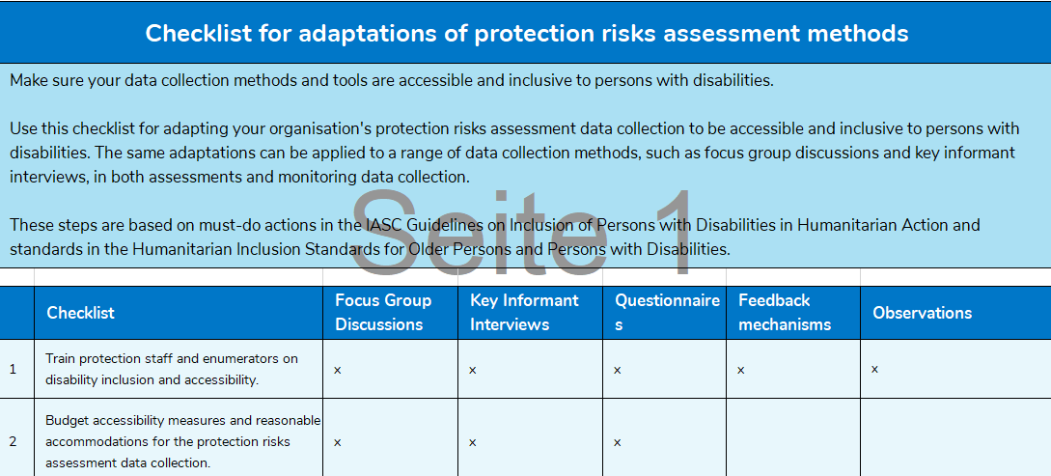
Checklist structure
Background & use
Column B, recommended actions

Slide 18
Limitations
Many organizations guard their assessment tools
  Received tools for review but not to share publically
  Limited sharing of good practices
Accessibility of excel documents: we employed design that allows for maximum readability
  Considering after user feedback -> alternate format for screen reader users
Time limitation:
  More time for consulting, testing and piloting would have been ideal -> version 1 -> based on feedback from users -> version 2

Slide 19

Input from Pauline Thivillier,
MEAL Advisor, OXFAM Novib

Slide 20
Experience on use
Why this has been helpful tool?
  Decision on where and how to start
  Scoring versus prioritizing
  Provides answers to questions
Example of Use
How was it helpful
Lessons Learnt

Slide 21
Adaptation to your needs & interests
Tool is excel based
Can be adapted to your organization needs
  If no SOPs/ guidance -> remove the tab 3 on SOPs
  If no observation grid -> remove Tab 10 & adapt the Tab 6 checklist
  If no demographic sections -> remove the Tabs 4 & 5 on demographic sections
  Etc.

Slide 22
Comments, questions?

Slide 23
Where to find it?
The Excel guidance
The How-to-note
For more information about our From Guidelines to Action project, download our project flyer.

Slide 24
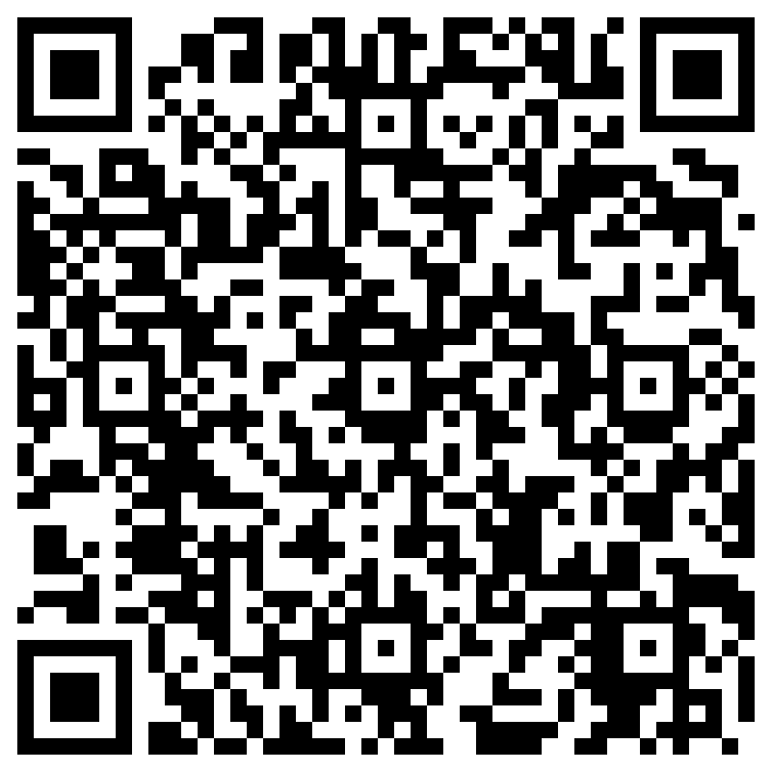
We value your feedback!
Please take a few minutes to share your feedback with us
Link to the survey
Or scan the QR code

Slide 25

Any last
questions?
Thanks a lot!
For any specific questions, contact:
u.last@hi.org
g.scirocco@hi.org
i.mulunda@hi.org
Copyright HI

